Slide 1
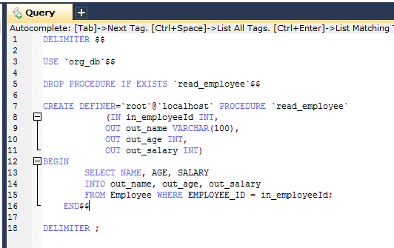
Calling a stored procedure with SimpleJdbcCall
The in_employeeId parameter contains the id of the employee you are looking up.
The out parameters return the data read from the table.

Slide 2
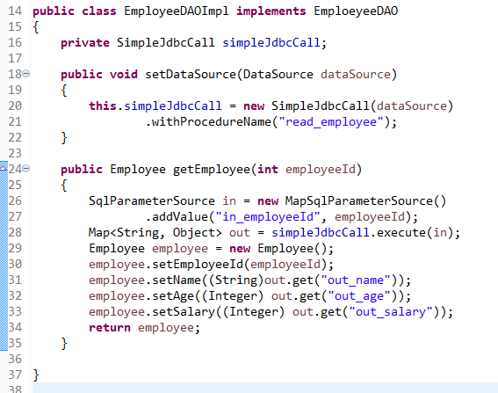
Calling a stored procedure with SimpleJdbcCall
The SimpleJdbcCall is declared in a similar manner to the SimpleJdbcInsert. You should instantiate and configure the class in the initialization method of your data access layer.
The code you write for the execution of the call involves creating an SqlParameterSource containing the IN parameter. It’s important to match the name provided for the input value with that of the parameter name declared in the stored procedure.
It is important to use the names of the out parameters as they are declared in the stored procedure.
The execute method takes the IN parameters and returns a Map containing any out parameters keyed by the name as specified in the stored procedure

